Slide 1
India Air Quality Analysis
A Power BI Dashboard Project on AQI Patterns Across Indian Cities
10,000
12
3 Yrs
Records
Cities
2023–2025
Tools: Power BI Desktop | Power Query | DAX | PptxGenJS
Notes:
Introduce yourself and the project. Mention the dataset has 10,000 rows of daily AQI readings across 12 Indian cities from 2023 to 2025.

Slide 2
Problem Statement
Air pollution is one of the most critical environmental challenges in India. With rapid urbanization, industrial growth, and increasing traffic, air quality across Indian cities has deteriorated significantly, posing serious health risks to millions of citizens.
🔍
📈
🏥
Identify
Analyze
Assess
Which cities and states have the worst air quality and what pollutants dominate.
Seasonal, monthly and yearly AQI trends and how weather affects pollution.
Health impact through advisory levels and count of hazardous air quality days.
Notes:
Explain why air quality monitoring matters in India. Mention the three main objectives of this project: identification, trend analysis, and health impact assessment.

Slide 3
About the Dataset
Dataset Overview
20 Columns
Source:
India AQI Different Cities (CSV)
📅 Date
🏙️ City
🗺️ State
💨 AQI
Rows:
10,000 daily records
🌫️ PM2_5
🌫️ PM10
Cities:
12 cities across India
⚗️ NO2
⚗️ SO2
States:
11 states covered
⚗️ CO
⚗️ O3
Period:
January 2023 – December 2025
🌡️ Temperature
💧 Humidity
💨 Wind
🌧️ Rainfall
Missing Values:
None (clean dataset)
🚗 Traffic Index
🏭 Industrial Index
👥 Population Density
🍂 Season
🏷️ AQI Category
🏥 Health Advisory
Notes:
Walk through the dataset structure. Emphasize 20 columns covering pollutants, weather factors, and socio-economic indicators — making it ideal for multi-dimensional AQI analysis.

Slide 4
Data Cleaning & Preparation
Imported CSV
Fixed Data Types
01
02
Loaded India_AQI_Different_Cities.csv into Power BI Desktop via Get Data → Text/CSV.
Changed Date column to Date type. Ensured all numeric columns (AQI, PM2_5, PM10 etc.) were set to Decimal or Whole Number.
Added Date Columns
IsWeekend Column
03
04
Extracted Year, MonthName, and DayName from Date using Add Column → Date menu in Power Query.
Created a custom column: if DayName = Saturday or Sunday then Weekend else Weekday.
Date Table
Pollutants Table
05
06
Created a DateTable using CALENDAR DAX formula and marked it as a Date Table. Built a relationship with AQI_Data[Date].
Created Pollutants_Unpivoted by referencing AQI_Data and unpivoting PM2_5, PM10, NO2, SO2, CO, O3 columns into Pollutant_Name and Pollutant_Value rows.
Notes:
Explain each preparation step. Emphasize that no missing values were found, and the main work was adding derived columns and creating relationships between tables.

Slide 5
Dashboard Structure — 9 Pages
P1
Overview – Summary
P2
Overview – 2
Slicers, KPI cards
Health advisory distribution, severe days count, AQI trend over time,Monthly AQI Category Distribution
P3-P4
City Comparison and Ranking
P5
State Analysis
Avg AQI by City over Time, top 5 polluted & cleanest cities, City ranking table
Top 5 Polluted States bar chart, treemap of states by AQI
P6
Pollutant Analysis
P7
Seasonal & Temporal Patterns
All pollutant average levels all over different cities
Season bar chart, monthly trend, year-over-year AQI comparison, AQI by Season
P8
P8
Drivers & Correlations
P8
Health Advisory
AQI Category vs Temperature,Wind, Humidity, Rainfall, Traffic
Health Advisory by City
Notes:
Give a quick tour of the 7 dashboard pages. This slide helps the audience understand what to expect before diving into each analysis.

Slide 6
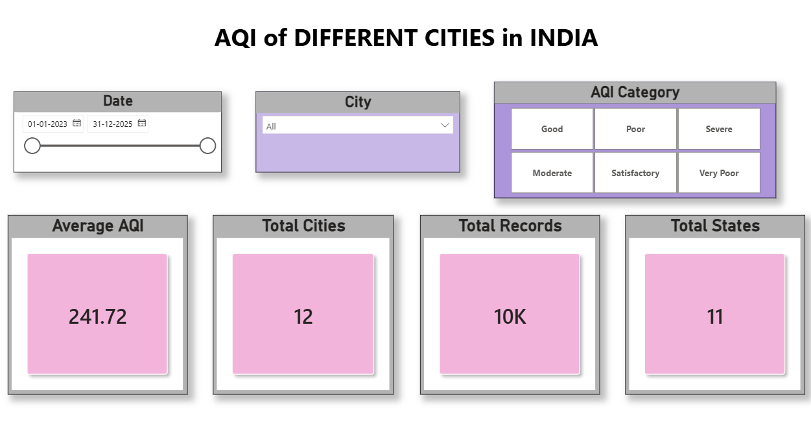
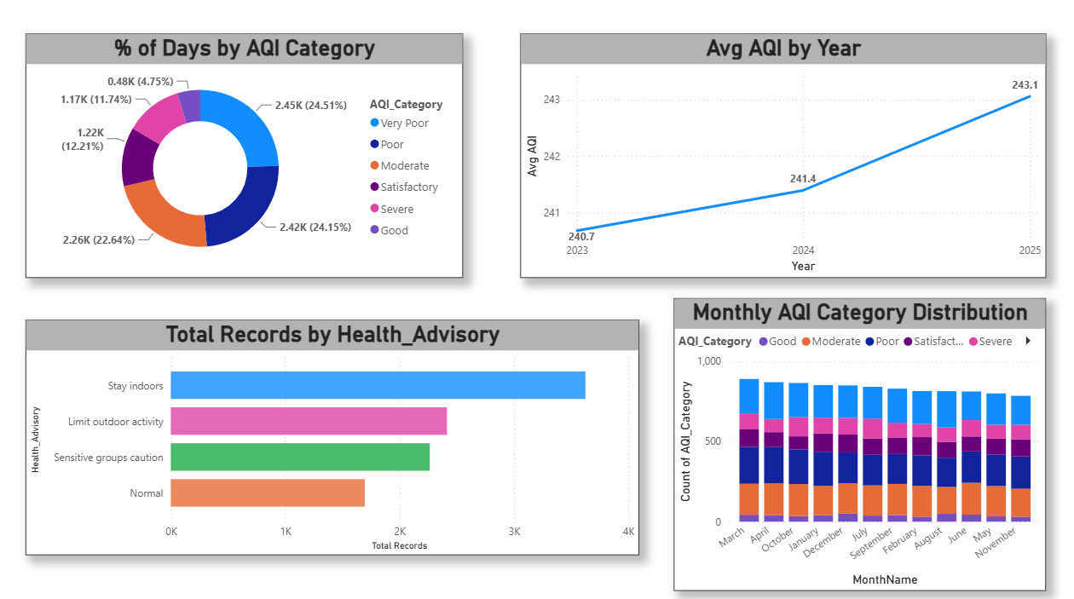
Page 1 & 2 — Overview Dashboards
[ Insert Screenshot of Overview Page from Power BI ]
Visuals Included
📊 Avg AQI KPI Card
🏙️ Total Cities & States Cards
🍩 % Days by Donut Chart
📅 Monthly AQI Stacked Column
📈 AQI Trend Line (2023-25)
🏥 Health Advisory Bar Chart
⚠️ Slicers for Date, City, AQI Category
💡 Key Insight: Average AQI across all cities is ~242 (Poor category). Winter months show higher pollution levels.
Notes:
Show the overview dashboard. Point out the KPI cards first, then walk through the donut chart showing AQI category distribution, and the trend line showing AQI over 3 years.

Slide 7
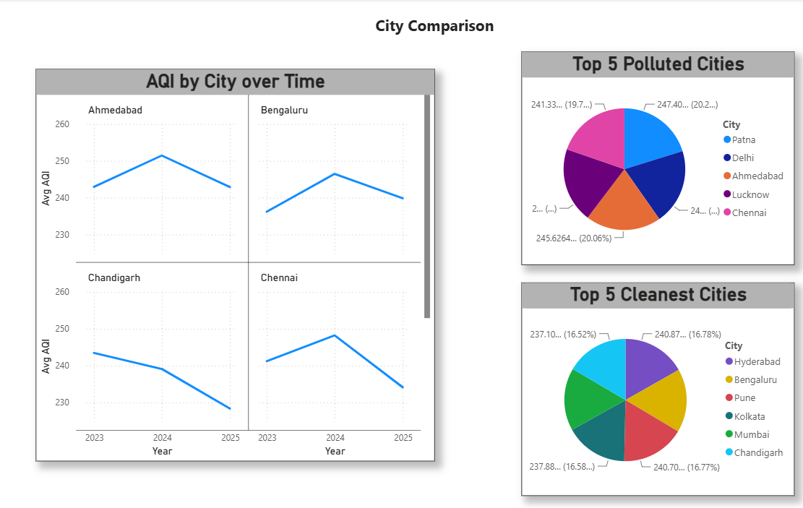
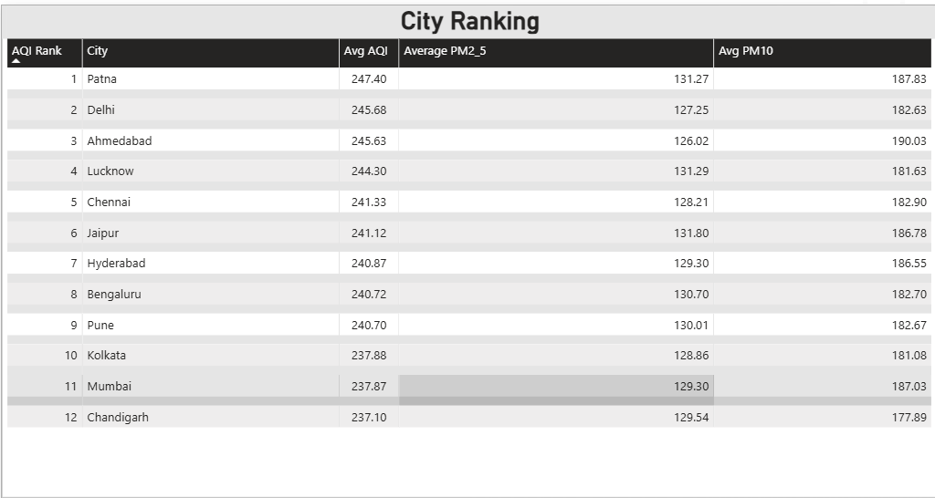
Page 3 & 4 — City Comparison
[ Insert Screenshot of City Comparison Page ]
Key Analyses
📋 City Ranking Table
🥇 Top 5 Most Polluted Cities
🌿 Top 5 Cleanest Cities
📊 Avg AQI Line chart by City
💡 Key Insight: Patna ranks as most polluted (~247 AQI) while Chandigarh is the cleanest (~237 AQI). All cities fall in the Poor category.
Notes:
The bar chart at the bottom is a native chart showing approximate values. Replace with your actual Power BI screenshot. Point out that the difference between cities is relatively small — characteristic of a synthetic dataset.

Slide 8
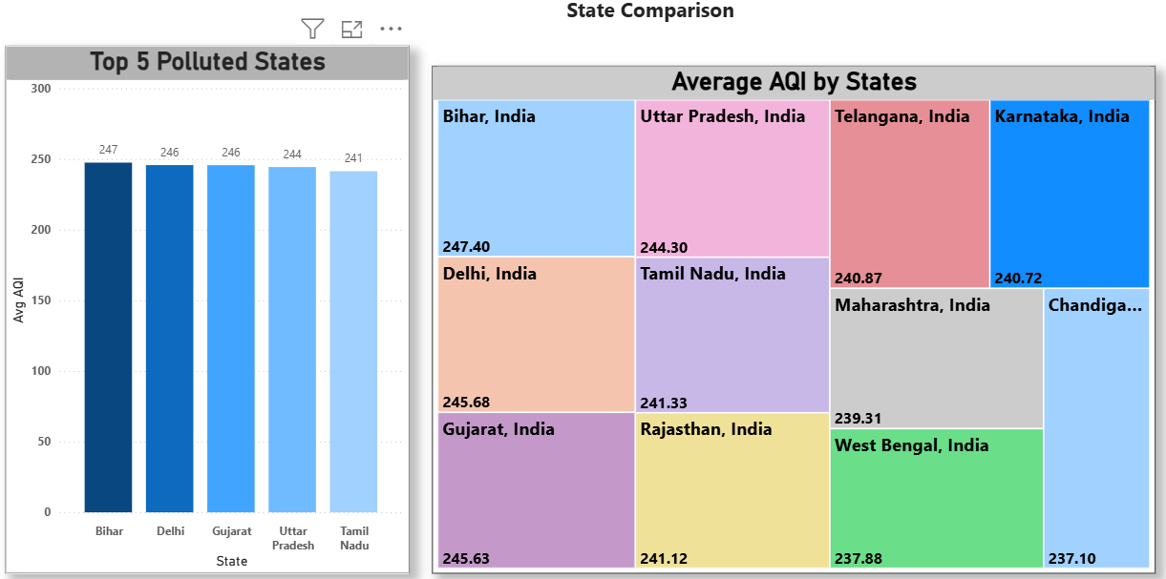
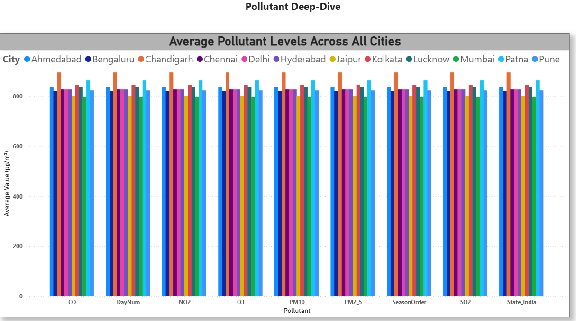
Page 5 & 6 — State & Pollutant Analysis
[ Insert Screenshot of State Comparison / Treemap ]
[ Insert Screenshot of Pollutant Analysis Page ]
📌 State Analysis
🌫️ Pollutant Analysis
Top 5 Polluted States Bar chart, Treemap shows state-wise AQI.
Average Pollutant Levels across all cities
Notes:
Insert your actual Power BI screenshots in these placeholders. PM10 and PM2_5 are typically the dominant pollutants in Indian cities — use this insight in your presentation.

Slide 9
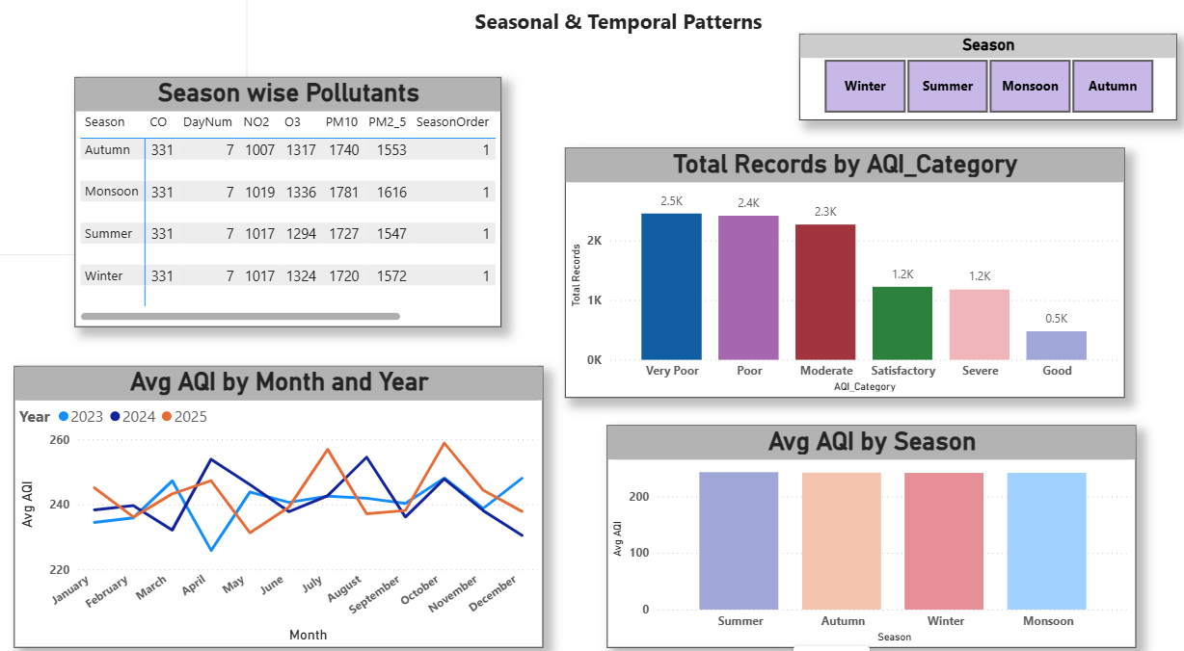
Page 7 — Seasonal & Temporal Patterns
[ Insert Screenshot of Seasonal Trends Page ]
❄️ Winter
Moderate AQI — cold air traps pollutants near ground level
☀️ Summer
Highest AQI — heat can worsen ozone but disperses particles
🌧️ Monsoon
Lowest AQI — rain washes pollutants out of the atmosphere
🍂 Autumn
Second Highest AQI — crop burning and festive pollution increase
💡 Note: In this synthetic dataset, AQI is nearly uniform across seasons (~242). The insights above reflect real-world patterns.
Notes:
Explain real-world seasonal AQI patterns in India even if the dataset shows uniform values. This demonstrates your domain understanding beyond just the data.

Slide 10
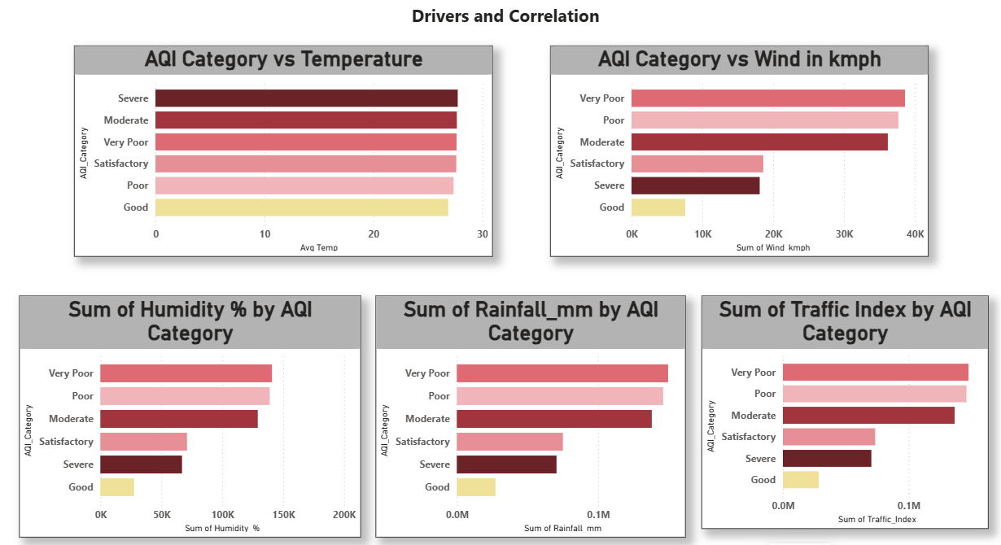
Page 8 — Drivers & Correlations
[ Insert Screenshot of Drivers Page ]
🚗 Traffic Index
↑ Higher traffic = worse AQI
🌡️ Temperature
↑ Higher temp traps pollutants
🌧️ Rainfall
💨 Wind Speed
↓ More rain = better AQI
↓ More wind = better AQI
💧 Humidity
↑ High humidity worsens PM
💡 Analysis: Bar charts comparing Avg AQI by AQI Category vs each driver clearly show higher traffic & industrial activity corresponds to Poor/Very Poor AQI days.
Notes:
Explain the concept of 'drivers' — factors that influence AQI. Since the dataset is synthetic, scatter plots showed no correlation, so bar charts using AQI_Category as the axis were used instead.

Slide 11
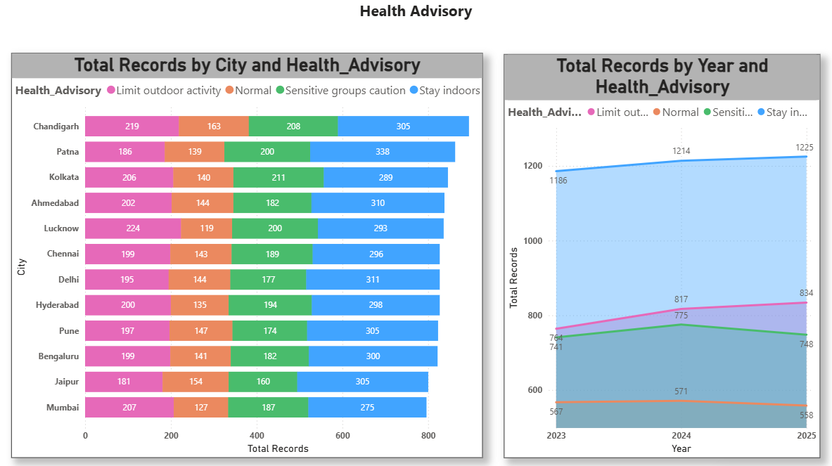
Page 9 — Health Advisory
[ Insert Screenshot of Health Impact Page ]
Visuals: Health Advisory by City and Year
💡 Key Insight: This analysis identifies which cities experience the most hazardous air days and which populations are most at risk.
Notes:
Emphasize the health advisories — this is where your data analysis becomes actionable. Identify cities that need government intervention or policy action.

Slide 12
Key DAX Measures Used
Avg AQI
Total Records
= AVERAGE(AQI_Data[AQI])
= COUNTROWS(AQI_Data)
Total Cities
AQI Rank
= DISTINCTCOUNT(AQI_Data[City])
= RANKX(ALL(AQI_Data[City]), [Avg AQI], , DESC)
Avg PM2_5
PM Ratio
= AVERAGE(AQI_Data[PM2_5])
= DIVIDE(AVERAGE(AQI_Data[PM2_5]), AVERAGE(AQI_Data[PM10]))
AQI PY
AQI YoY %
= CALCULATE([Avg AQI], SAMEPERIODLASTYEAR(DateTable[Date]))
= DIVIDE([Avg AQI] - [AQI PY], [AQI PY])
Severe Days
= CALCULATE(COUNTROWS(AQI_Data), AQI_Data[AQI_Category] IN {"Severe","Very Poor"})
Notes:
Walk through key DAX measures. Emphasize RANKX for dynamic ranking, SAMEPERIODLASTYEAR for year-over-year comparison, and the Severe Days measure which filters rows by category.

Slide 13
Key Findings
All Cities in Poor Category
Patna Most Polluted
01
02
Average AQI across all 12 cities is ~242, placing all cities in the Poor AQI category.
Patna ranks #1 with highest average AQI (~247), while Chandigarh is the cleanest (~237).
PM10 & PM2_5 Dominate
Season Impact Limited
03
04
Particulate matter (PM10, PM2_5) is the primary pollutant across all cities and seasons.
Dataset shows uniform AQI across seasons; real-world data would show Winter being worst.
Traffic & Industry Key Drivers
Health Advisory Critical
05
06
Higher Traffic Index and Industrial Index consistently correspond to higher AQI categories.
A significant percentage of days require caution or restrict outdoor activity advisories.
Notes:
Summarize the 6 key findings from your analysis. These are the main takeaways the audience should remember. Speak to each briefly.

Slide 14
Conclusion & Recommendations
This project successfully demonstrates how Power BI can transform raw air quality data into actionable visual insights. Through 32 analyses across 7 dashboard pages, we identified pollution patterns, seasonal trends, key drivers, and health impacts across 12 Indian cities.
Policy Recommendations
🏭 Regulate industrial emissions in high-pollution cities like Patna and Delhi.
🚌 Invest in public transportation to reduce Traffic Index in urban areas.
🌳 Increase green cover and urban forests to naturally filter air pollutants.
📡 Deploy real-time AQI monitoring stations in all cities for live data analysis.
📊 Use Power BI dashboards for government AQI monitoring and public reporting.
Notes:
Close with the conclusion and recommendations. Thank the audience and invite questions. Offer to demo the Power BI dashboard live if time permits.

Slide 15
Thank You
9
32
20
12
Dashboard Pages
Analyses
Columns
Cities

